Slide 1

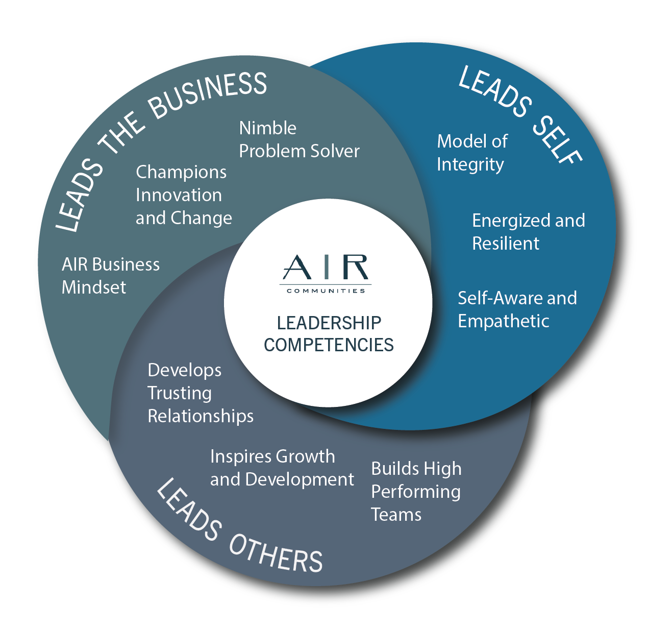
THREE DIMENSIONS
NINE COMPETENCIES
SEVEN LEADERSHIP BEHAVIOR STATEMENTS FOR EACH COMPETENCY
Click thru slides >

Slide 2

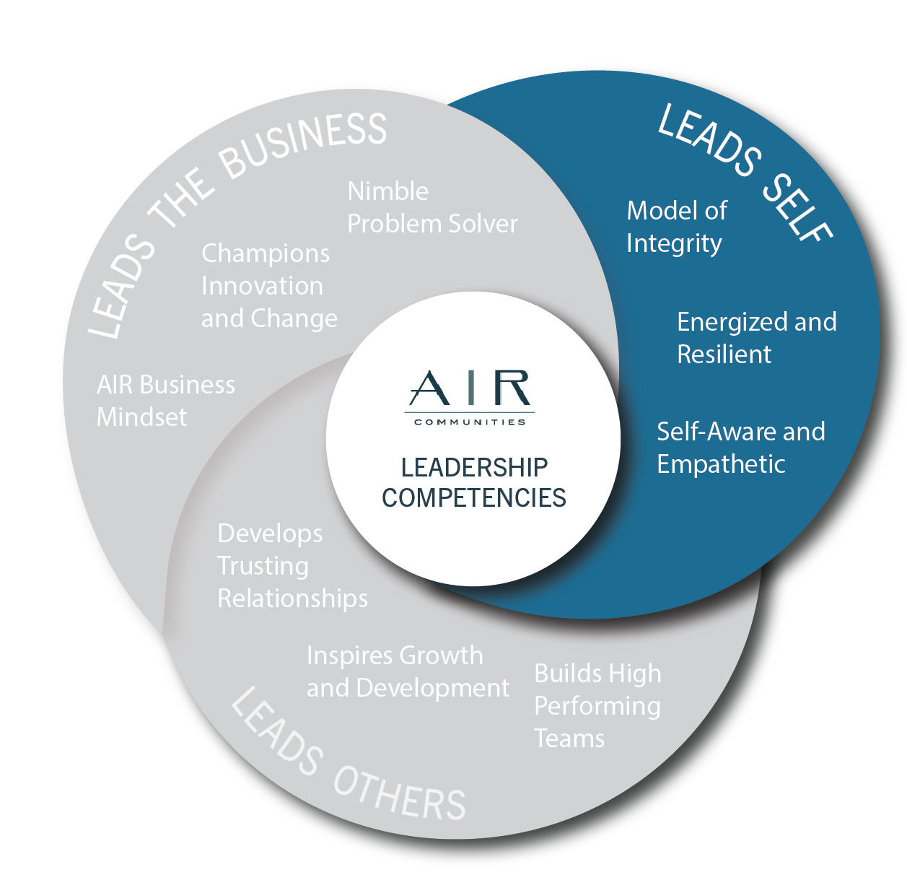
MODEL OF INTEGRITY
Through words and actions, encourages honesty throughout AIR
Leads by example - “Walks the talk"
Does the right thing, even if difficult or unpopular
Is trustworthy and trusting of team members
Follows through on promises
Speaks candidly about tough issues facing AIR
Is accountable for actions - does not blame others - “Owns it”
ENERGIZED AND RESILIENT
Is optimistic - displays a positive attitude
Is determined - committed to success
Maintains composure under stress
Can deal well with setbacks - bounces back from failures
Is a self-starter - eager to learn and grow
Responds well to new situations that requires stretch and growth
Contributes more to solving organizational problems than to complaining about them
SELF-AWARE AND EMPATHETIC
Understands own strengths and weaknesses accurately (i.e., knows themself)
Is tuned into how their behaviors affect others
Doesn't let power or status go to their head
Adjusts leadership style according to the demands of the situation
Responds effectively when given feedback
Adept at viewing a situation through others' eyes
Shows interest in the needs, hopes, and dreams of other team members

Slide 3

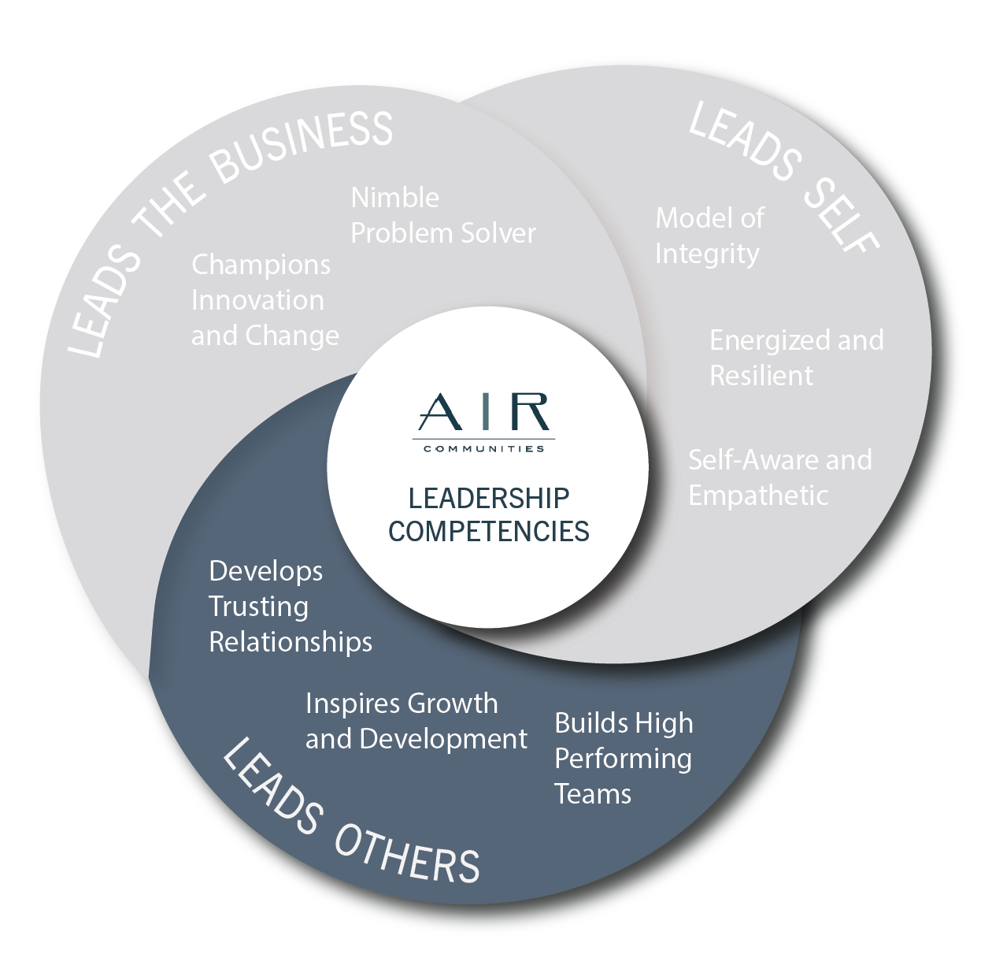
DEVELOPS TRUSTING RELATIONSHIPS
Has an approachable personality that puts team members at ease
Is skilled at relating to many different types of people
Models teamwork by working effectively with other leaders throughout AIR
Is able to inspire, motivate team members - to spark others to take action
Values others’ perspectives as much as their own
Listens more than talks - genuinely interested in other’s viewpoint
Is effective at managing conflict
INSPIRES GROWTH AND DEVELOPMENT
Energizes team to go the extra mile
Helps team members to see the importance of what they are doing
Provides team members with guidance when needed
Develops team members through constructive feedback and encouragement
Delegates work that provides substantial responsibility and visibility
Challenges team members to push beyond their comfort zone - to stretch themselves
Acts as a mentor, helping others to develop and advance in their careers
BUILDS HIGH PERFORMANCE TEAMS
Sets and maintains high standards - stretch goals
Assigns clear accountability for important objectives
Promotes a spirit of continuous improvement
Encourages direct reports to share concerns, ideas, suggestions
Pushes decision making to the lowest appropriate level and develops team members' confidence in their ability to make those decisions
Proactively addresses conflicts and disagreements that affect team effectiveness
Shows confidence in the team and celebrates successes

Slide 4

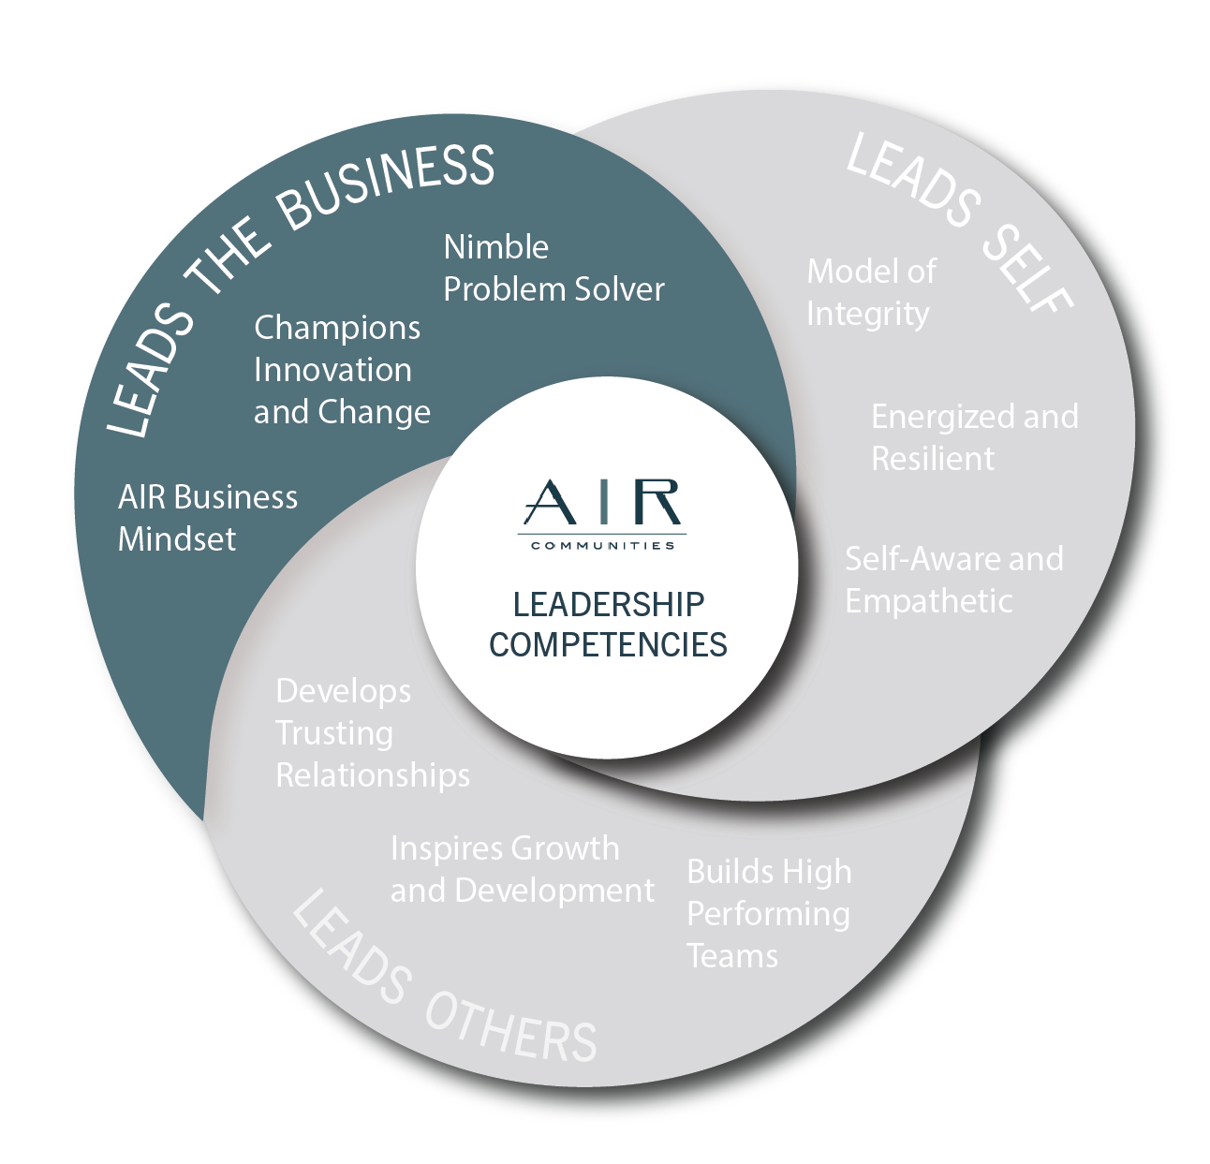
AIR BUSINESS MINDSET
Is passionate about seeing AIR succeed
Knows how the various parts of AIR fit together
Understands the goals of different functional areas in AIR
Is recognized as a subject matter expert in current role
Has an understanding of the industry that goes beyond own area
Stays abreast of industry trends and happenings to build new knowledge and skills
Is a role model of providing excellent service and work product
CHAMPIONS CHANGE AND INNOVATION
Adapts to changing conditions and circumstances easily
Is open to new ideas and trying new methods
Acts as a change agent - supports the continual need to change
Takes into account team members' concerns during change
Champions company change initiatives in a way that helps team members understand, appreciate, and support them
Takes calculated risks
Thinks outside the box to create new and different ways of solving problems
NIMBLE PROBLEM SOLVER
Enjoys solving problems and tackling daily, unpredictable events
Is optimistic - says "yes" to finding an answer
Proactively calls out problems while also providing recommendations and solutions
Involves those closest to the situation when making decisions - even when in different departments or areas
Makes fact-based decisions and avoids overanalyzing
Implements timely decisions, follows through, follows up well
Appropriately modifies plans and tactics in response to changing conditions

Slide 5
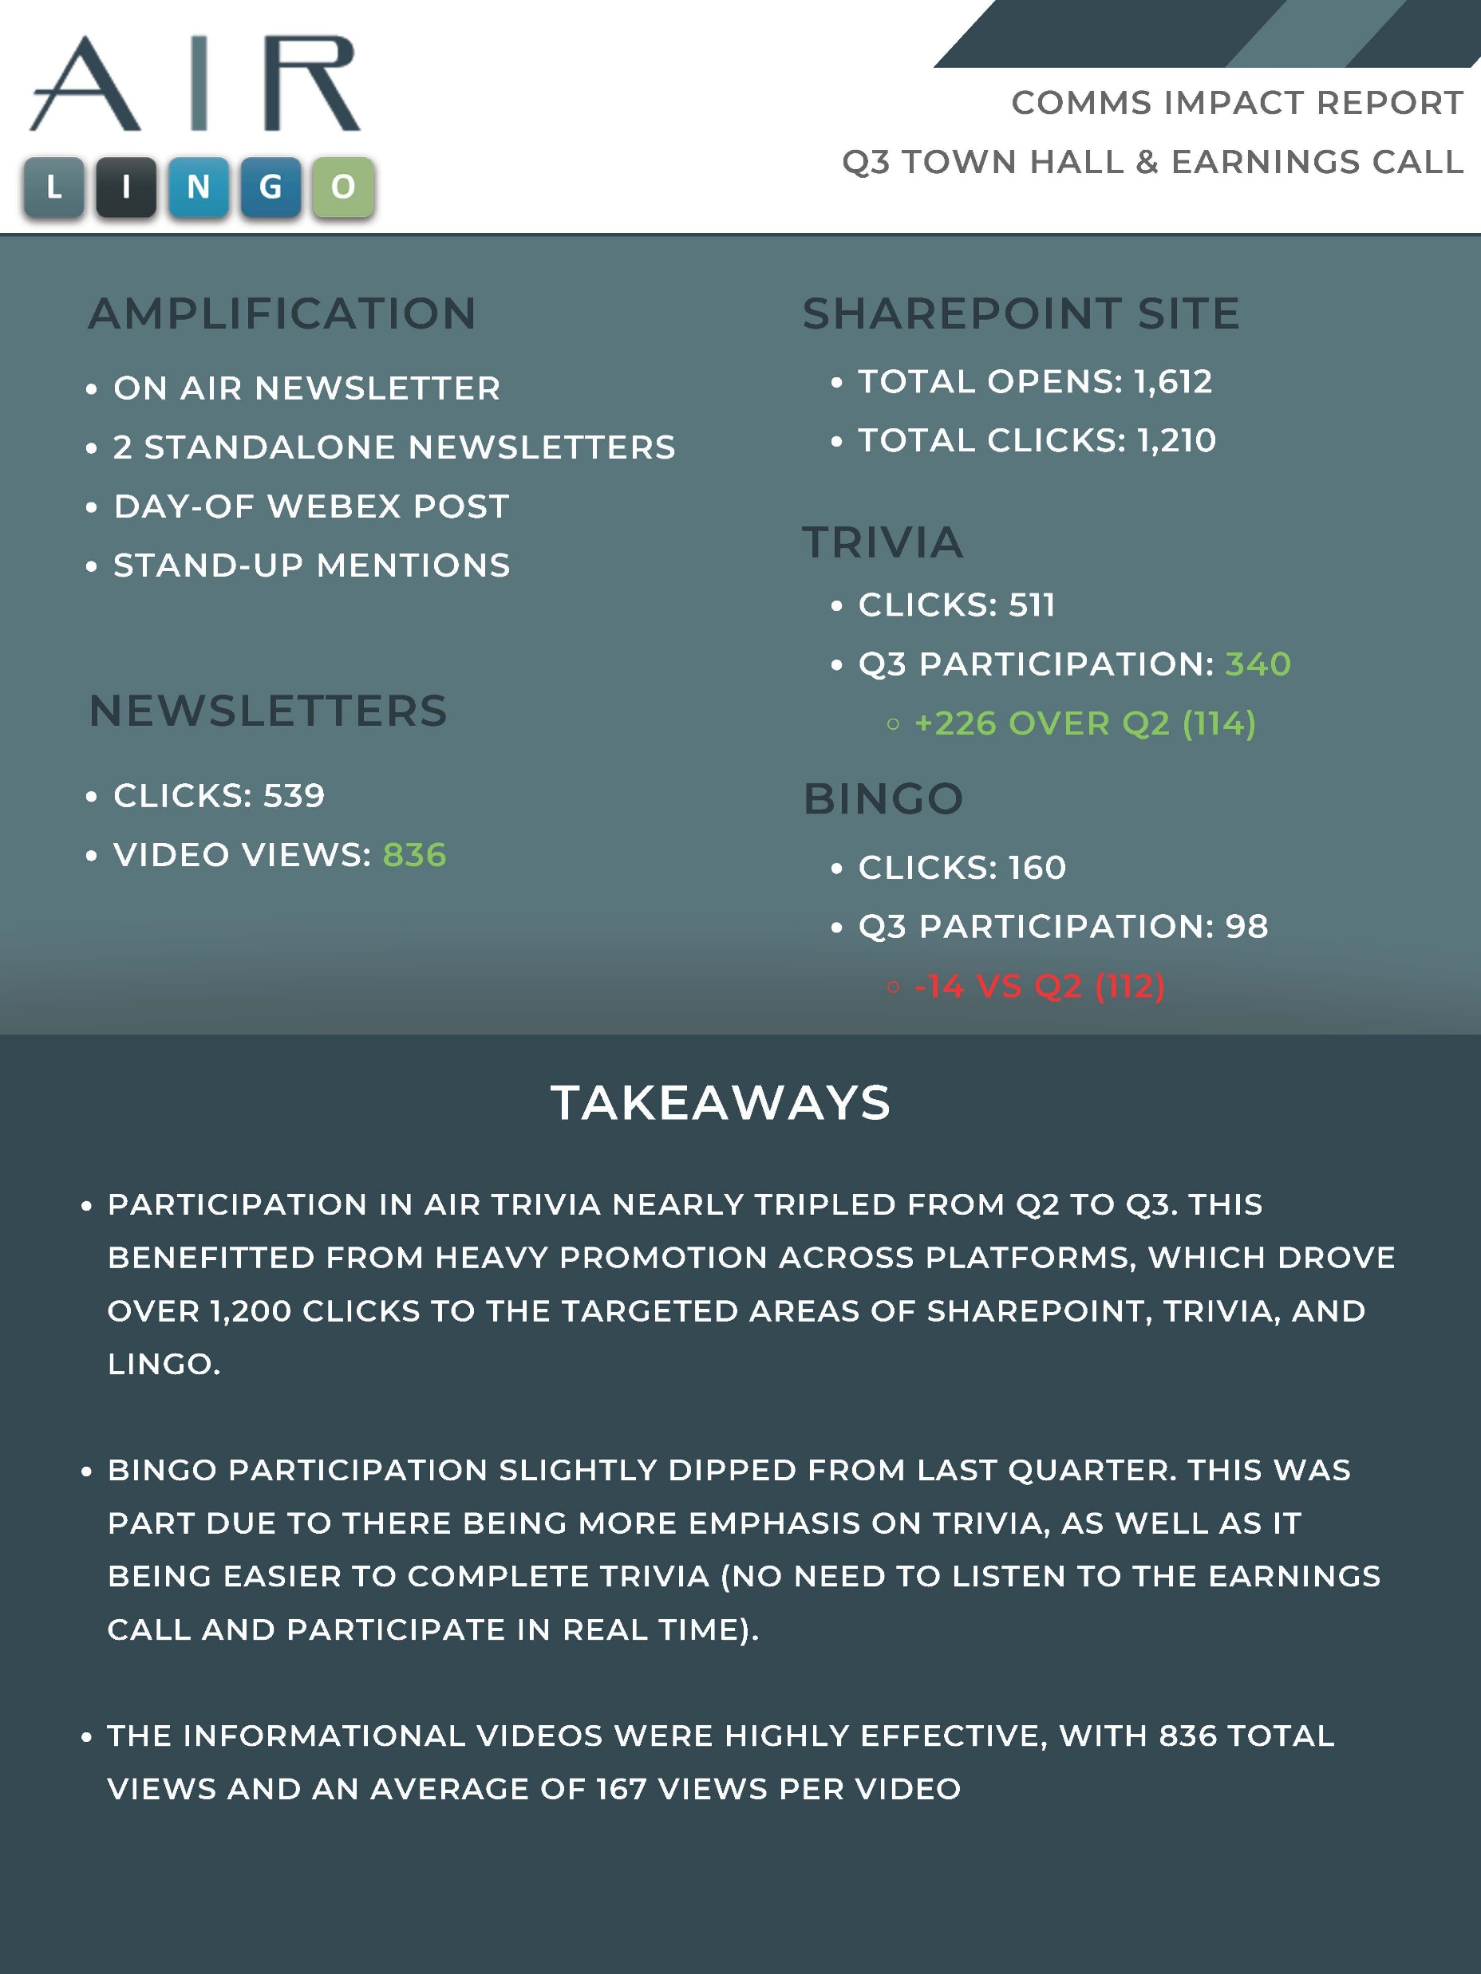
AIR BUSINESS MINDSET
AIR BUSINESS ACUMEN - “AIR LINGO”
To strengthen the AIR Business Mindset, build engagement across the organization, and support career mobility, we rolled out an interactive business acumen program introducing key industry terms.
We produced a new video each week with one of our leaders explaining a term or metric related to their area of expertise.
We hosted trivia and bingo contests for prizes and it was a hit! Everyone tuned into Town Hall calls not only for the chance to win at bingo but because they had a better idea of the terms being used in these reports.
Watch some of the videos we produced and maybe you too will learn something new.

Slide 6

BUSINESS ACUMEN Videography

Slide 7
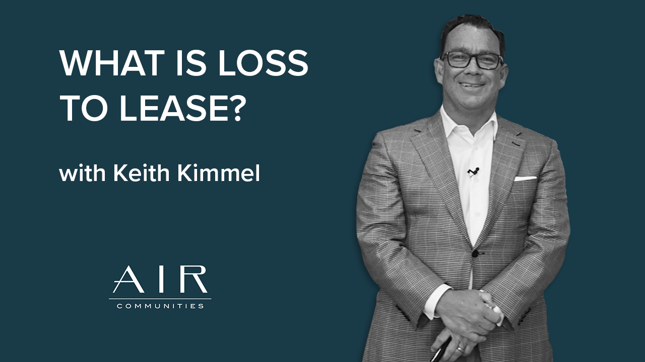
BUSINESS ACUMEN Videography

Slide 8
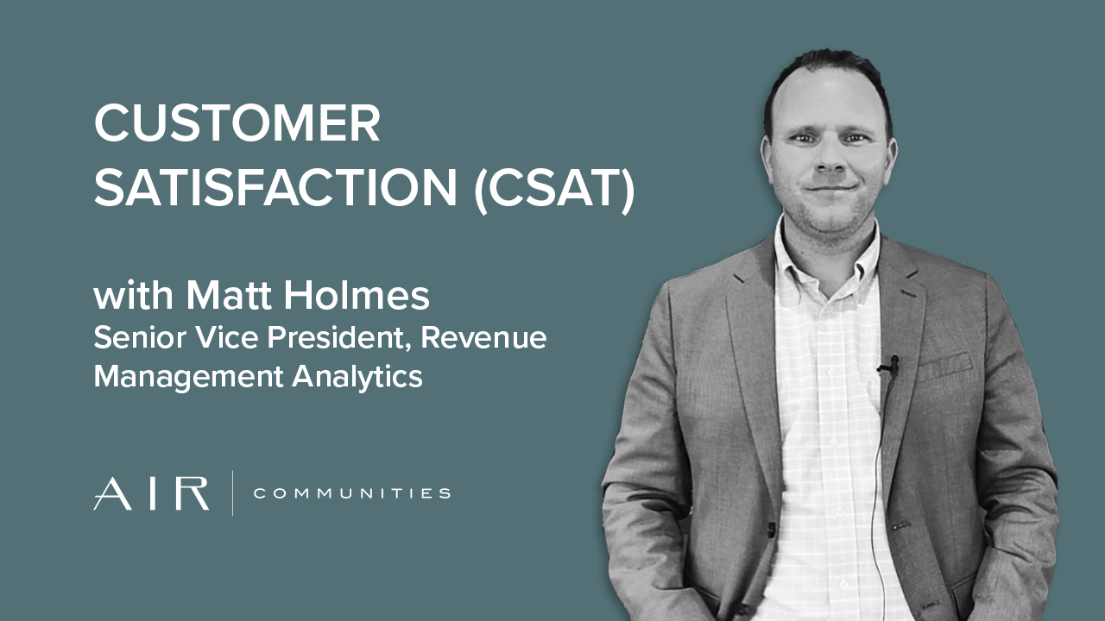
BUSINESS ACUMEN Videography

Slide 9

BUSINESS ACUMEN Videography

